Slide 1
Developing MicroServices
July, 2017
Continuous Deployment Platform
Dewayne Hafenstein
Principal Technical Architect

Slide 2
You are HERE!
CDP101 – Introduction to MicroServices
CDP202 – Domain Driven Design
CDP103 – Introduction to the Continuous Deployment Platform
CDP104 – Introduction to Standard Tools and Frameworks
CDP205 – Using the MicroServices Catalog
CDP206 – Developing an Application Using MicroServices
CDP207 – Developing MicroServices
CDP308 – MicroServices Problem Determination and Monitoring
CDP409 – Using Docker Containers
CDP410 – Using Kubernetes
101
202
103
104
205
You are HERE
206
207
308
409
410

Slide 3
Your Course Outline
Introduction
Reviews microServices and introduces the sample application.
MicroService Design
Recaps the Doman-Driven Design process and summarizes analysis and design.
Understanding and Employing Patterns
Explains patterns, their motivations, and their purpose.
Environment Setup
What to do before using Eco to generate your microService
Generating the microService
Explains the generation process and how Eco does it
Structure of an AJSC microService
Describes the generated project’s structure, including project directory and its artifacts.
Design and Documentation
How to document APIs and extend generated documentation to include other resources
Perform Local Testing
How to locally test a microService without deploying to a container or running it on a server
Building the microService
How to build the microService locally
Quick View Page
Your Course Overview
This course explains how to design, write, build, package, deploy, and support a microService using the standard tools, frameworks, and processes. You can work through the course at your own pace. It may take 5 to 8 hours to complete this course, including the self-check exercises.
Intended Audience
Developers and Architects
Prerequisites
CDP206

Slide 4


Before You Start
You’ll need to see both the slide and the notes section below. If you don’t see the notes section, click on “Notes Page” within the “View” tab. If viewing the presentation as a slide show, you may also see the notes on the presenters page.
Notes are not visible using the PowerPoint Viewer.
Notes:
These slides have a significant amount of notes added to them to explain the content.
This is done so that reading the notes is essentially what an instructor leading the course would have said.
There is a good amount of explanation in the notes that may be missed if you look only at the slide.
The notes can be viewed using several different approaches. If you are viewing the presentation as a slide show, the presenters view will show the slide and the notes. If you have opened the presentation in PowerPoint, you can view the notes using one of several means:
Select the “View” menu, then select “Notes Page”
In the normal view, use your mouse to select a divider along the bottom of the slide and move it up. This will show both the slide and the notes.
Please note, if you are using the power point viewer, the notes will not be visible. You will need to use PowerPoint to view the presentation content in its entirety.

Slide 5
Contents
Introduction
Design of the MicroService
Understanding and Employing Patterns
Environment Setup
Generating the MicroService
Structure of an AJSC MicroService
Design and Documentation
Performing Local Testing
Building the MicroService

Slide 6
MicroServices
You should understand what a microService is now…
A microService is …
…an independently created, supported, and deployable business domain service,
…running in a container on a managed runtime environment,
…performing one domain function (a bounded context),
…with complete encapsulated ownership and management of all of its data,
…with its operations exposed over a lightweight API, and is
…loosely coupled to any other microServices and/or applications through only its API.
The benefits of using microServices correctly are:
Reduced Costs
Increased Speed
Improved Quality
Enhanced Customer Experience
Introduction
Notes:
MicroServices are not any new technology, but rather the adoption of specific best practices, design guidelines, CI/CD, and loose coupling all geared towards accomplishing several goals.
These goals are to reduce costs, increase the speed of delivery, improve the quality, and by doing these things improve the customer satisfaction with the applications.

Slide 7
MicroServices and Databases
A microService and its data must be encapsulated
What this means is the microService has full and exclusive control of its data.
The data is logically part of the microService and no other application, microService, or process can access the microServices data for ANY reason!
The database is accessed by the microService remotely just as databases are accessed today. If another microService or application needs access to the data, it must do it through the API of the microService.
Encapsulation is important to prevent building dependencies on the microServices data structure or content. If the microService is not free to make any changes, enhancements, or refactoring to its data store, then the independence of the microService, quality, speed, and cost goals all suffer.
This does not mean structural encapsulation, but rather encapsulation of control and ownership.
Runtime Framework
Database Server(s)
micro
Service
Container
NO!
Control and Ownership “Encapsulation”
micro
Service
DB
App
NO!
Introduction
Notes:
MicroServices are deployed into containers with ephemeral file systems that are dynamically created, destroyed, and moved as needed by a management runtime. This makes the container a poor choice for any database server for numerous reasons. Instead, databases should be separate from the microService instance, running in their own controlled and managed environments, and accessed remotely by the microServices. This allows the microServices to move as needed, while still being able to access their data. The database servers and persistent storage should be managed much the same way as databases are managed today.
Encapsulation in this context refers to the access, ownership, and control of the database, the schema that describes the database, and the data contents of the database. The database must be exclusively owned and accessed by the microService. If any other microService or application has access to the database, even in read-only mode, then a dependency is formed that prevents, or complicates, any enhancements or changes to the database schema to accomplish desired features of the microService. If that were allowed to happen, and a change was needed, it would now have to be coordinated between all applications and microServices that access the database. This complicates and slows the adoption of changes, and may force undesirable technical debt and workarounds, which compromise quality and cost savings.
Instead, any other application or microService that needs access to the data would request that data through the API of the owning microService. This allows the implementation to change as needed, while maintaining the same interface and isolating the other applications and services from the changes. It allows the microService to change independently of all other applications and microServices, and to change in a way that is best for that microService implementation. This results in much faster availability of new features, higher quality and less cost.

Slide 8
Notes on Samples
All samples in this class are for Java microServices based on AJSC6.
The concepts and techniques are the same for all implementation languages.
The process is the same for all implementation languages.
Similar tools and capabilities often exist in other languages, but they are not referenced herein.
Anything specific to AJSC6 will be called out as such in the course.
Introduction
Notes:
The sample microService is actual code that runs. It has been zipped and attached to this presentation and can be used as an example. The attachment is at the end of the materials.

Slide 9
Contents
Introduction
Design of the MicroService
Understanding and Employing Patterns
Environment Setup
Generating the MicroService
Structure of an AJSC MicroService
Design and Documentation
Performing Local Testing
Building the MicroService

Slide 10
Domain-driven Design/DDD
Domain-driven Design/DDD is important for the design of microServices
Domain-driven Design/DDD focuses on the domain operations and events first.
It is a “top-down” approach that identifies common domain activities.
Modeling the domain activities and developing the ubiquitous language will identify the different bounded contexts.
During analysis and design, use the same language everywhere
Use the language of the SME and business domain – DO NOT INVENT A NEW LANGUAGE!
Use the language consistently; be precise and clear.
Ensure that the language is used consistently by everyone in the project and in all documentation.
Design of the MicroService
Notes:
Domain-driven Design/DDD is most frequently used to design microServices.
It is based on the idea of top-down, business process-oriented design.
You first identify your business activities and the events that occur.
During this process you will identify the various domains and discover the entities and aggregates that are needed, all the while identifying and documenting the ubiquitous language, and developing the design of the various domains.
The domains that result in the design are usually the boundaries for the various microServices.

Slide 11
Develop Scenarios and the Ubiquitous Language
Develop scenarios to explore the domain activities
Data is identified later in the process.
Unlike ERA and other techniques which focus on the data first, DDD focuses on the processes first.
Do not try to model the data before identifying the contexts and domain activities.
The domain activities will lead you to the data.
Do not convolute the data to server multiple purposes.
This is a clear indication of separate bounded contexts because the meaning of the data is changing based on the context of its usage.
Scenarios explore the different ways the system will be used.
Scenarios…
…define the business activities.
…specify a specific use case for a specific user (actor).
…may identify business rules and constraints.
…usually identify acceptance criteria.
Design of the MicroService
Notes:
A good way to understand your business domain in DDD is to develop scenarios or use cases that explore the various processes.
This will enable you to discover the various activities that are being performed, and to identify the various boundaries where the context changes. For example, if your core business domain is payment management, and includes things like scheduling, processing, and reversing payments for items, the concept of a payment is slightly different for different methods of payment.
A credit card payment is different from an ACH payment, and both are very different from a money order, check, or cash.
These different payment contexts are not part of the core context, but are rather used by it to perform the process of payment management.
There are likely many related operations for credit cards, ach, money orders, and checks that are also different, and specific to each of those contexts. Therefore, on the surface at least, these appear to be separate domains.
As you proceed through the analysis, you may find other areas where the context changes, and that can help you identify the various boundaries.

Slide 12
Develop the Domain Model
Develop the Domain Model
During analysis, all terminology, concepts, activities, use cases, entities, aggregates, and events are recorded and make up the domain model.
The domain model evolves during analysis AND during the life of the product.
It is during analysis that we will identify the different bounded contexts.
Challenge and Check the domain model constantly
You should ensure that the domain model is accurate at all steps along the way.
When adding a new concept, entity, event, or aggregate to the domain model, check to make sure that the model is still correct afterwards.
Design of the MicroService
Notes:
As you perform DDD, you will be recording everything you discover as part of the domain model. The domain model is the collection of all knowledge gained from the analysis process. This should not be confused with the Enterprise Architect (EA) “Domain Model” view in an EA Model, if you are using EA. These are NOT the same things.
In DDD, the domain model is the collection of all knowledge, and includes use cases, activity diagrams, erds, class diagrams, schemas, terminology, and all other tools used to document the domain model. Note, the domain model in this context is the knowledge, not the actual diagrams used to express that knowledge (just for clarity).
In Sparx System’s Enterprise Architect (EA) product, which is a very good tool for capturing and documenting design using UML and other technologies, the use of “views” allow you to explore a model from multiple perspectives.
Think of the model as a multi-dimensional artifact (like a Rubik’s Cube), trying to understand every dimension simultaneously is not possible, especially with complex systems.
Instead, it is easier to try to understand smaller, focused, and specific aspects of the design, and use these multiple “views” to build-up a complete picture.
The “Domain Model” view is a view that EA provides for describing the various activities, sequences, states, and other behavioral aspects of the model. It is NOT the same thing as the DDD domain model, which in this case would encompass the entire EA model and all views.

Slide 13
Develop the Bounded Contexts
Develop the Bounded Contexts
During analysis, you should get an idea of what the different contexts are in a business domain relatively quickly.
Then, these contexts will be refined during analysis and may be broken down further if needed.
Bounded contexts are developed during analysis
They represent contexts where every entity inside that context has one definition.
The definition of a customer for example is always the same, it means the same thing, and it behaves the same way everywhere in the bounded context.
In an online sale application, an “order” may mean different things to different contexts. Since the meaning changes, and the data associated with the entity, these would be different bounded contexts.
It is the contents of a package to the “Shipping” context.
It defines the amount to be billed to the “Billing” context.
It defines the item to be pulled from inventory to the “Warehouse” context.
In each of these bounded contexts, the entity is an “Order”. We do not create a “BilledOrder”, “ShippingOrder”, or “PickOrder” entity. Each context defines their view of an “Order” and uses it in a consistent manner inside that context.
Design of the MicroService
Notes:
The bounded contexts are simply boundaries where any specific concept, idea, or element does one, and only one, thing.
For example, in the earlier example of the payment management system, a payment could represent some money transferred to us for the delivery of some service or item.
However, as we move into credit card processing, the payment has an additional contextual meaning of money debited from a specific credit card number, BIN, and CVV code.
In ACH, the payment would have a different context, and would detail the bank routing and transit number, account number, and other information. So, within payment processing, the “meaning” of payment changes as it moves through the process.
Everywhere the meaning of payment changes is a boundary between different contexts. Everywhere the meaning of payment is exactly the same is a single bounded context.
In this example, payment management, credit card processing, and ACH processing are different bounded contexts.

Slide 14
Define the Events
Start defining the Events
As the processes are understood, you will start to identify what events may be generated.
Events are published to any other context(s) that want to subscribe.
They provide information about what processes were requested.
The provide information about the outcome of the process.
They can be used by downstream contexts to propagate processing as needed.
Events provide loose coupling and easy extension.
Additional contexts could subscribe to the events and perform additional processing at any time without affecting the context generating the event.
Events are the mechanism to allow for “eventual consistency” across all of the bounded contexts.
Design of the MicroService
Notes:
One of the essential requirements of using bounded contexts is to provide loose coupling between different contexts and to rely on eventual consistency across a domain and all of its sub-domains. The way this is done is to generate events as processes occur and state changes inside a bounded context. Other bounded contexts can then listen for the events (based on their type), and take any needed additional processing. This event-based mechanism allows additional bounded contexts to be added later that may also be interested in the event without affecting any existing bounded contexts.
As business processes and the entities and aggregates are defined, the events are also defined. Whenever a payment is created, an event to that effect is generated. It is simply published to some event distribution mechanism, such as a Jms topic, from where other microServices could subscribe and process those events. Durable subscription would ensure that events are not dropped or lost in the event that a downstream microService was not available at some point in time.

Slide 15
Model the Entities, Value Objects, and Invariants
Model the Entities and Value Objects
Start identifying the data entities and value objects as you define the processes and refine the bounded context.
Ensure that the meaning of each entity is constant throughout the context.
Refactor the context if the meaning changes.
Capture and model the domain invariants
A domain invariant is some rule that is always applied to one or more entities under certain conditions.
These invariants are business rules that define data consistency and behaviors.
Design of the MicroService
Notes:
Also during analysis, as the business activities are defined, the entities that they operate on, the value objects used, and the aggregates and invariant business rules are captured and documented.

Slide 16
Design the Aggregates
Start designing the Aggregates
As entities and invariants are defined, start to model the aggregates.
An aggregate implements the invariants.
Aggregates must be atomically consistent (all entities inside an aggregate change in the same transactional boundary).
How to Design “Good” Aggregates
Design small aggregates.
Protect business invariants within aggregates.
Determine update latency.
Refactor aggregates.
Repeat.
Design of the MicroService
Notes:
Start small.
Design the first set of aggregates around the smallest identified concepts. This ensures that the aggregates will be as small as possible, but after performing all of the other steps, not too small. If the aggregates are too small, business invariants may be spread across multiple aggregates. This is a mistake that is addressed by the second step.
Next, identify the business invariant rules and apply each rule to one, and only one aggregate.
If the business rule applies to more than one aggregate, refactor those aggregates into a single aggregate to accommodate the business invariant.
The third step is to ask the SMEs for the update time frames that are needed for each aggregate.
If the customer were to change something on that aggregate, how long is acceptable for the other aggregates to reflect that change? This is performed for each aggregate so as to identify when there is an immediate update needed across aggregates. For each aggregate, determine what the update latency requirement is and for aggregates that have an immediate update requirement, consider refactoring those aggregates together to form a new aggregate. This step tends to refactor small aggregates into larger aggregates, and is contradictory to step 1. Be careful that the business doesn’t insist that every Aggregate update have immediate consistency. It can be an especially strong tendency when many in the design session are influenced by database design and data modeling. Those stakeholders will have a very transaction-centered point of view. However, it is very unlikely that the business really needs immediate consistency in every case. To change this thinking you will probably have to spend time proving how transactions will fail due to concurrent updates by multiple users across different entities of the (now) large aggregate.
Refactoring aggregates is a continual effort. The goal is to get the “right sized” aggregate and is accomplished by performing this analysis repeatedly until a satisfactory aggregate emerges. The steps can be repeated as many times as needed to get a good aggregate design.

Slide 17
Define the Context Mappings
Start defining Context Mappings
A bounded context may need to interact with other bounded contexts…
…to obtain data.
…to request services.
The data models are likely not the same.
There are multiple ways (Context Mapping) some bounded context data model can be made usable to another bounded context.
Partnership
Shared kernel
Customer-supplier
Conformist
Anti-corruption Layer
Open Host Service
Published Language
Separate Ways
Design of the MicroService
Notes:
As you proceed through the analysis phase, there will become evident specific boundaries.
These boundaries are where the context of an item changes, and are used to define the bounded contexts.
The bounded contexts will interact with each other, sharing information back and forth. However, that information will be slightly different in those different contexts.
After all, the context boundary was created because that was where the data meaning changed.
At this point, you must decide how you want to control that interaction. How do you want to translate or share the meaningful information from one context to another? There are several well-defined patterns that can be used and are defined as part of the DDD methodology. Each has pros and cons, and you will need to select whatever method is best for your case.

Slide 18
Iterate
Iterate and Refine
DDD is not a waterfall process. It is iterative!
Each time you perform some analysis you will learn more.
Each refinement causes the domain model to become more accurate and more reflective of the business domain.
All of the parts work together. They all tend to help self-check the model.
Retain the domain model artifacts and use them!
DOMAIN MODEL: Good source of domain knowledge!
The domain model is as much source material for the project as any programming code.
The domain models represent the knowledge of the domain.
They should be used, protected, and enhanced over the life of the project.
CODE: Not a good source of domain knowledge!
Code represents an implementation of the model, and only one of an infinite number of implementations.
It is not a good source of domain knowledge!
Design of the MicroService
Notes:
DDD is not a single-pass-and-your-done methodology.
It is not a cookbook, or a process, or even a check list.
It is an iterative approach, it cannot be performed sequentially because in all but the most trivial cases you will not be able to know everything in each “step”.
As you discover information, you will refine things that you though you knew, and will generate more questions, which will lead to more discovery. However, after you iterate a few times, the level of discovery will diminish. Will it ever go to zero? Probably not. Most domains are far to complex to effectively model every aspect. Besides, business domains do change over time, so even if you could capture everything that exists today, in a while, there will be changes that need to be made.
So, how do you know when to stop the iteration? That is not an easy question to answer, but generally when the iteration does not provide any appreciably new information, and the risk of stopping the iteration is low (the risk that anything undiscovered may cause serious impact or damage to your design).
The SME’s in the business domain are the best sources of information about determining if you have enough design or not.
It is a risk-vs-reward proposition.

Slide 19

Check Your Progress

Slide 20
Exercises
A+
Design of the MicroService
In DDD, you perform the process of analysis and design once and then your done. | True/False
All concepts or elements within a single bounded context have one, and only one, meaning and behavior. | True/False
One of the benefits of microServices is that “bounded contexts” are to a degree flexible and arbitrary; therefore, you can create the bounded contexts as you see fit and are no longer quite so tied to the business processes and entities. | True/False
The domain model consists of just the behaviors of the domain. | True/False
Context Mapping is the process of determining how two or more contexts exchange information. | True/False

Slide 21
Contents
Introduction
Design of the MicroService
Understanding and Employing Patterns
Environment Setup
Generating the MicroService
Structure of an AJSC MicroService
Design and Documentation
Performing Local Testing
Building the MicroService

Slide 22
What are Patterns
Patterns are generally reusable solutions to common problems
They demonstrate approaches to solving specific problems.
They are not a finished design that can be used directly.
They are a description or template for how to solve a problem that can be used in many different situations.
They are are formalized best practices that the programmer can use to solve common problems when designing an application or system.
So, to use patterns, the developer needs to…
…understand the problem(s) that they are facing.
…understand the method that each pattern uses to address the issue(s).
…understand how to adopt the pattern(s) to their implementation.
Understanding and Employing Patterns
Notes:
In order to use a pattern effectively, the designer needs to understand:
the problem they are trying to solve, and
the motivations behind each pattern, what problem they are solving, how that applies to their problem, and how to adapt the pattern to their needs.
Patterns are NOT cookbook solutions!
They are not drop-in implementations.
They are intended as appropriate ways to address specific problems that have been tired and proven.
They may require adapting to your specific problem, or you may require using multiple patterns in combination to solve certain design problems.
You do not generally select the pattern then develop the microService, rather you define what the microService needs to do and determine from that what issues you may need to solve, then select appropriate patterns and adapt them to your needs.

Slide 23
OO Design Patterns
The evolution of patterns can be traced back to the Gang of Four (GoF) Book
“Design Patterns: Elements of Reusable Object-Oriented Software” by Eric Gamma, Richard Helm, Ralph Johnson, and John Vlissides
GoF
The GoF book divided patterns into three groups:
Creational Patterns
Structural Patterns
Behavioral Patterns
Of these three groups, Structural Patterns are most interesting to us in microServices
Structured Patterns
Structural patterns address issues with:
How to compose objects,
How to define relationships, and
How to interface between objects.
Many of these patterns can be directly applied to microServices as well.
Understanding and Employing Patterns
Notes:
It became evident early on in object-oriented design that there were general approaches that were best used for solving certain types of architectural problems.
In the early days, designers had to figure these out for.
The breakthrough event for patterns in software architecture can generally be traced to the book “Design Patterns: Elements of Reusable Object-Oriented Software”. The book was written by four of the most advanced practitioners of object-oriented design, and became known as the “Gang of Four” book (or simply, the GoF).
The success of this book is evident by the widespread use of the terminology they used in the book.
Prior to the book, we had no universal notion of a “Factory” pattern. That was the term they used, and it is now universally used and understood.
Their terminology and descriptions have been used in countless other books and publications, design materials, and in conversations.
The terminology has been adopted as a de-facto standard.

Slide 24
Different Patterns Exist
The GoF OO patterns, DDD Context-Mapping patterns, and AT&T microService design patterns are all similar and overlap, but they serve different purposes
Gof Object-Oriented Patterns
The GoF patterns document architectural approaches to types of Object-Oriented structural problems and issues.
DDD Context Mapping
DDD Context Mapping patterns describe ways that the domain model of one context can be used in another context.
MicroService Patterns
The AT&T microService patterns describe ways that a microService, user interface, and system of record can be assembled.
Understanding and Employing Patterns
Notes:
Since the success of the GoF patterns book, and the whole notion of using recognized patterns as solutions to specific problems, patterns have been defined and used in all sorts of ways.
The DDD methodology suggests several patterns for how to interchange information between various bounded contexts, collectively called the Context Mapping.
Enterprise architecture patterns have been defined for the best ways to solve specific problems in distributed component systems, such as Service Locator, Business Façade, and others.
The microService patterns address different ways that could be used to assemble microServices and to interface them with systems of record, user interfaces, and other approaches.
This does not mean that you cant still use GoF patterns within the microService patterns, and even JEE patterns, all at the same time.
A microService is not implemented by one single pattern, but may use any number of patterns to meet its objectives.

Slide 25
Review of Some of the GoF Structural Patterns
GoF Structural Pattern | When to Use the Pattern
Adapter | A technique to provide a linkage between two otherwise incompatible types. The adapter pattern “wraps” the object that supports the interface that is required, and adapts it to a form that is compatible with the requestor. This is used typically to change the interface of some subject to a form that is compatible with the requestor. It “adapts” the subject to the needs of the client. Use Adapter when you need to change an existing interface (or set of interfaces) to meet the needs of the client.
Façade | It defines a manner for creating relationships between classes or entities. The facade design pattern is used to define a simplified interface to a more complex subsystem. Use Façade whenever you need to filter, simplify, or aggregate complex services. It can be used to aggregate the services provided by multiple microService to a simpler, higher level of abstraction.
Proxy | It defines a manner for creating relationships between classes or entities. The proxy design pattern is used to provide a surrogate or placeholder object, which references an underlying object. The proxy provides the same public interface as the underlying subject class. It adds a level of indirection by accepting requests from a client object and passing these to the real subject object as necessary. Use proxy whenever you want to expose the same set of operations, but need to perform caching, redirection, or other types of injection of control in the interaction between the client and the service.
Understanding and Employing Patterns
Notes:
There are several structural patterns that are described in the GoF book.
Of these, the most commonly used ones are the Adapter, Façade, and Proxy.
The adapter pattern is primarily used to convert a set of operations and/or the data they use to conform to the target services needs.
For example, you may have an application or microService that needs to invoke an operation of another microService. The target mS requires data in a single object that you may have to obtain from multiple objects in your context, the data required by the target service may not be represented the same way in your service, or you may have to call several operations to achieve your desired results. In this case, the “Adapter” is used to adapt one service or application to another, much the same way a physical cable adapter allows one type of cable to be connected to a different type.
The façade pattern is used to put a false front on something else and to expose a different set of capabilities.
An example of a façade is the false front on a building on a movie set. On the street, you may see a western town complete with saloon, jail, and general store. Behind these false fronts may be totally different buildings, and are often just empty lots.
The façade presents a view of something that is different than what it covers. Facades are useful to simplify complex operations, supply default behaviors, or to aggregate multiple operations into a simpler or more usable operation.
The proxy pattern is a stand-in for the real thing.
A proxy is some object that looks, acts, and appears to be the real object, but really simply delegates to the real object.
Proxies allow the information to be cached, and for connections to the back-end object to be dynamic or re-routable.
The proxy can completely contain the mechanisms to connect to and use the back-end service, and can provide other infrastructure-like behaviors, such as security, auditing, logging, and caching.

Slide 26
DDD Context-Mapping Patterns
DDD Context Mapping | When to Use the Pattern
Partnership | Partnership is not so much a pattern for context mapping as much as it is an agreement to use the same domain model and to be bound by the same constraints, goals, and language
Shared Kernel | This is an agreement on some sub-set of the domain model of the service you want to interface with. The context that you are interfacing with defines the “kernel” of information that you agree to use and you use their definitions as-is.
Consumer-Supplier | The consumer is provided what they want by the supplier. The downstream microService provides what the upstream microService expects. It handles all of the transformations, mappings, or implementation of the upstream microService data.
Conformist | The downstream microService uses the domain model of the upstream microService as-is. The downstream microService conforms to the data model of the upstream microService. This is the opposite of the consumer-provider pattern.
Anti-Corruption Layer | The anti-corruption layer is implemented in the downstream microService and converts the data of the upstream microService to the data model of the downstream microService within the downstream microService. It “adapts” the upstream data model to the downstream data model and protects the data model of the downstream microService.
Open Host Service | This is a service-based approach that allows one microService to request operations on the domain data of another microService without actually having access to the data directly. The microService exposing the OHS service performs the operations as directed and manages the data within the microService.
Published Language | In this mapping, a completely separate “exchange language” (such as an XML schema) is used. The data is converted into and out of the exchange language by both microService. This protects and isolates the domain model of both microService.
Separate Ways | There is no mapping at all. No interaction between microService takes place.
Understanding and Employing Patterns
Notes:
The Domain-Driven Design methodology expressly defines eight different approaches to how information within one context can be shared with another context.
These patterns are referred to as the “Context Mapping” patterns, and include applications of adapters, facades, and proxies, as well as some other approaches like the partnership and shared kernel.
These patterns are specific to information sharing between different bounded contexts.

Slide 27
The AT&T MicroService Patterns
Patterns defined for standardizing approaches to common designs
There are six (6) groups of patterns that cover different categories, defined as pattern “types”.
Pattern Type | Description
1 | MicroServices that implement presentation layer services (UI/UX)
2 | MicroServices that integrate with other microServices
3 | Integration of microServices with non-microService (Legacy) implementations
4 | MicroServices that are the system of record for domain
5 | Caching of data in microServices
6 | MicroService context mapping
Understanding and Employing Patterns
Notes:
Likewise, AT&T has defined six types of patterns that are useful for how microServices can be used.
They define cases where the microService hosts the user interface, where the microService accesses other microServices that are the systems of record (SoR), and where microServices need to access and interface with non-microService systems of record.
These patterns also include suggested patterns for the use of data caches, both for accessing caches and for management of them.

Slide 28

AT&T MicroService Type 1 Patterns
Approaches to Using a MicroService to Host the User Interface
Pattern 1A – Local Cache
Pattern 1B – Composite
micro
Service
micro
Service
micro
Service
micro
Service
Understanding and Employing Patterns
Cache
SoR
SoR
The microService hosts the user interface.
Database used to support the UI/UX behaviors.
The microService serves content from a cache.
The microService hosts the user interface.
The microService interfaces with other microServices for System of Record.
Notes:
These are two suggested patterns for when the microService is hosting the user interface or presentation tier.
In the pattern 1A situation, the content is served from a cache of data.
The assumption here is that the cache is maintained by another, external microService or application. The use of a cache provides very fast information access and can be very responsive, but the data can become stale if the cache is not updated or processed frequently. This pattern is useful for rapid retrieval, update, or entry of information that can be staged and updated separately, where the currency of the information is not of paramount importance but rapid access is.
The pattern 1B approach is likely more common.
In this case, the UI/UX microService interacts with other microServices to obtain all information. This allows for easy information retrieval as well as information updates, and is more in-line with many UI/UX implementations today.

Slide 29
Important Note Regarding UI/UX
A microService that hosts a user interface does not change the basic architecture and responsibilities of the user interface
A microService does not redefine how UI/UX works.
An mS is the hosting server and container for the user interface/UI.
Inside the mS, the UI behaves as it would for a non-mS implementation.
A UI/UX mS should contain ALL of the related behaviors, pages, and resources
It should operate as a traditional web application.
The mS uses a standard web server, such as Jetty, Jersey, or Tomcat (AJSC includes this)
Just as in DDD bounded contexts, all of the behaviors that are in the same context should be in the same UI mS.
A UI mS can link to or reference (forward or redirect) if needed
State and session information should be maintained in the same mS
Any persistent state should be kept in a database or another mS.
No persistent state should be written to the file system of the UI/UX microService. Use an external database, data store, or another mS to persist that.
Understanding and Employing Patterns
Notes:
Web-based user interfaces deployed into a microService do not operate any differently than what you would do if you were deploying them into a web server running as a separate process. You would use the same design principles and guidelines that you do today. The mS-based web UI is a web application deployed into and running inside a web server that is running in the mS. All context and state maintained by the web application operates the same way. Session information can be created and retained, and the user interface can pin the users session to a specific mS using URL re-writing or cookies.
The mS that hosts the UI/UX components is hosting the web server, which in turn hosts the UI/UX implementation. Because the UI components are running in a microService, there is no persistent storage available to the microService natively. Instead, all persistent information (such as user preferences) should be stored in persistent storage, such as a remote database or obtained from another mS.

Slide 30
AT&T MicroService Type 2 Patterns
Approaches to Integrating Different MicroServices Together
Pattern 2A – Composite, No DB
Pattern 2B – Transformation
Pattern 2C – Composite, local cache
micro
Service
micro
Service
micro
Service
micro
Service
micro
Service
Micro
Service
cache
Micro
Service
Understanding and Employing Patterns
SoR
SoR
SoR
SoR
The microService operates as a façade or adapter.
Potentially aggregates operations of other microService and exposes new operations.
The microService operates as a proxy or adapter.
May transform or simplify operations.
The microService operates as a proxy or adapter.
May transform or simplify operations.
May cache data locally.
Notes:
These patterns are approaches to integrating two or more microServices together. In all of these variations, the actual interface between the different microServices is typically done using one of the Context Mapping patterns. This is needed to transform or adapt the information from one microService context to another.
Pattern 2A is likely a façade or adapter (GoF pattern) over the other microServices and is used to combine operations of the other microServices in a new way and to provide additional or different services. This pattern likely would not have any persistent store itself since it is not the system of record, but rather an adapter or façade on top of the other microServices.
Pattern 2B is likely an adapter or proxy pattern implementation that is used to transform, translate, or simplify the access to another microService.
Pattern 2C is similar to 2B except that it includes a local cache where the results of the transformation can be retained for rapid retrieval. Cache state management makes this pattern a little more complicated.

Slide 31
AT&T MicroService Type 3 Patterns
Approaches to Integration of MicroServices with Legacy Non-microService System
Pattern 3A – Facade
Pattern 3B – Caching Proxy
Pattern 3C – Transitional
Pattern 3D – Transitional
micro
Service
micro
Service
micro
Service
micro
Service
Cache
SoR
Legacy Application
Legacy Application
Legacy Application
Legacy Application
Understanding and Employing Patterns
SoR
SoR
SoR
SoR
The microService operates as a façade or adapter to a Legacy application.
The microService operates as a proxy and cache the SoR data in a local cache.
The microService operates as a proxy and recreates the SoR database for itself. Used to transition from a Legacy application to a microService SoR.
The microService operates as a proxy and accesses the Legacy SoR database directly. Used only for transition
to a microService approach.
Notes:
Pattern 3 and all of its variations are about how to adapt a microService based approach to a non-microService Legacy implementation. The preferred method is to access an API that exposes the needed capabilities directly from the microService (Pattern 3A).
In this case, the microService operates as a Façade over the Legacy application.
Pattern 3B is used when the Legacy application cannot, or will not provide an API access to the needed information.
In this case, direct access to the Legacy application data store is not optimal, but is the only method that can be used. To facilitate faster information access, the microService can employ a cache (this could also be performed in 3A if needed).
Patterns 3C and 3D should only be used as the last resort and only for transitional purposes to a different implementation. These are the least preferred methods.

Slide 32
AT&T MicroService Type 4 Patterns
Approaches to MicroService Database Configurations
Pattern 4A – SoR MicroService, Independent Databases
Pattern 4B – SoR MicroService, Independent Tables
Micro
Service
Micro
Service
Micro
Service
Micro
Service
SoR
SoR
Each microService controls its own separate database schema (including all of the tables defined within the schema).
Each microService controls its own separate tables but shares access to a common schema. The tables themselves are unshared.
Understanding and Employing Patterns
Notes:
These patterns show the various ways that data can be “encapsulated” into a microService.
Here, the term “encapsulated” simply means the ownership and control is encapsulated.
The data is not physically encapsulated as part of the microService deployment.
The database that hosts the data used by the microService is still accessed remotely, exactly as we do today with non-microService implementations.
This shows that the two appropriate methods are for each microService to have their own, unshared, private database with their own schemas and their own tables (Pattern 4A), or to share a database schema but have separate, unshared tables (Pattern 4B). Of these patterns, pattern 4A is likely the most preferred because it makes “accidents” much less likely.
In a shared schema, it is very easy to accidentally create data dependencies that may not even be detectable until a table is changed, at which point other services start failing.
This is why microServices should NEVER share data or allow access to their data store – it creates dependencies that cause issues when changes are introduced.

Slide 33
AT&T MicroService Type 5 Patterns
Approaches to Using a MicroService to Manage a Cache
Pattern 5A – API Driven
Pattern 5B – Event Driven
Pattern 5C – Read Through
Client
Micro
Service
micro
Service
Event
micro
Service
cache
cache
Micro
Service
cache
SoR
The microService populates and serves content from a cache.
The cache can be updated by input from the client of the microService.
The microService updates the cache from an event source.
The microService supports a read-through cache.
The local cache is searched first, then the SoR is accessed and used to update the cache.
Understanding and Employing Patterns
Notes:
These patterns show the various ways that a microService might use a cache to store and manage data. These patterns are usually used in combination with other patterns.
For example, pattern 1A could be the user interface implementation using a cache managed by another microService using 5B, just as an example.
Typically, the management of the cache is not the end use of the data, but rather some intermediate layer used by another service.

Slide 34
AT&T MicroService Type 6 Patterns
Approach to MicroService-to-MicroService Interaction
Pattern 6 – MicroService-2-MicroService Interaction
Micro
Service
Use the Context Mapping patterns from Domain-driven Design/DDD as appropriate.
This is true for all microService to microService interactions.
SoR
Micro
Service
SoR
Understanding and Employing Patterns
Notes:
This pattern shows that two different microServices, each their own System of Record, can interact with each other to share information that is not part of their domain or to request services.

Slide 35
Check Your Progress

Slide 36
Exercises
A+
Understanding and Employing Patterns
A microService implements a single pattern. | True/False
A pattern is chosen and the microService implements it exactly as described. | True/False
A pattern is an example of a way to solve a specific architectural problem, and can be adapted as needed to meet the needs of the microService. | True/False
The GoF patterns have no applicability in microServices. | True/False

Slide 37
Contents
Introduction
Design of the MicroService
Understanding and Employing Patterns
Environment Setup
Generating the MicroService
Structure of an AJSC MicroService
Design and Documentation
Performing Local Testing
Building the MicroService

Slide 38
Setup the Environment
Some initial setup is required
Follow the microService governance process.
A “mechid” is suggested to be used for all building and deployment of the microService.
ALL applications that are run in production data centers in AT&T require a MOTS (Mechanized Operational Tracking System) ID.
All microServices need to be part of a specified namespace.
All namespaces must be known to AAF and other tools.
All microServices must be defined in the microService catalog.
The namespace chosen needs to be configured to Jenkins, Sonar, and Kubernetes.
After the initial setup, then use Eco to generate the microService
Eco uses templates to initialize the microService project.
Generation is done only once, after that it is manual development as usual.
Environment Setup

Slide 39
MicroService Governance Process
Follow the microService governance process
MicroServices must be registered in the microService catalog.
MicroServices must be approved and funded.
There is an entire process for getting microServices projects started.
Environment Setup

Slide 40
Mechid
A mechid is recommended
All access to services must be authenticated to some known ID.
Users have an ATTID.
Mechanisms (or software systems) have a mechid.
A mechid can…
…avoid configuration changes needed if a personal ATTID were used and the person changes.
…segregate logged activities from those performed by actual users.
…protect the build process.
…protect the microService implementation .
Environment Setup

Slide 41
A Namespace is Required
The namespace is needed by nearly all tools, and is used to identify the microService
The namespace specifies a “group” or “organization” that the microService is part of.
Namespaces are specified using a hierarchical name, with dots (periods) as the name separator character.
The namespace ensures global uniqueness.
com
??
google
att
namespace
??
cdp
??
training
com.att.cdp.training
Environment Setup
resource

Slide 42
Set up the SCM Project
An SCM project will need to exist
You will need a Git project.
If you already have one, that should work. If not, you will need to create one.
Add your mechid as an authorized user to the tools
Eco will use the mechid to initially generate the microService project contents in the Git repository.
Jenkins will use the mechid to access the repository to build the microService.
Sonar will use the mechid.
Define your namespace to the tools
Eco will need to know your namespace.
Jenkins will need to know the namespace.
Kubernetes will need to know the namespace.
Environment Setup

Slide 43
Setup Instructions
The one-time set up of the environment is fully documented on the wiki
Refer to the CDP wiki site for detailed information about the set up process.
As tools are added, there may be additional set up needed in the future.
As the process is further automated, this set up process may change and be simplified.
The setup is only needed ONCE
Once the namespace, mechid, catalog, and the Git repository have been set up, they are simply used for that microService over its lifetime.
These tools and systems retain the definitions and use them to access the various resources.
Unless the mechid, namespace, or microService name changes, the configuration should not need to be changed.
Environment Setup

Slide 44
Check Your Progress

Slide 45
Exercises
A+
Environment Setup
You do not need to follow the governance process. | True/False
You do not need to register your microService in the catalog. | True/False
You do need an AAF namespace for your microService. | True/False
A mechid is recommended for access to all of the tools and frameworks used to build your microService. | True/False
You will need to provide a CodeCloud (Git) project for the microService. | True/False

Slide 46
Contents
Introduction
Design of the MicroService
Understanding and Employing Patterns
Environment Setup
Generating the MicroService
Structure of an AJSC MicroService
Design and Documentation
Performing Local Testing
Building the MicroService

Slide 47
Eco
Eco is the CDP tool to generate the microService
Eco uses templates to define the initial generation.
The template supplies the initial definition of the pipeline (CI/CD process).
The template supplies the initial project contents.
Eco creates the project repository in Git for you.
Eco creates the pipeline for you.
Eco can manage the pipeline for you.
Once generated, the microService project is then developed and advanced as for any other project
Eco is used to initially generate the contents of the project, then the development team uses IDEs and other tools to enhance and add to it.
Eco can manage the building of the microService project using the pipeline over the life of the microService project.
Generating the MicroService

Slide 48
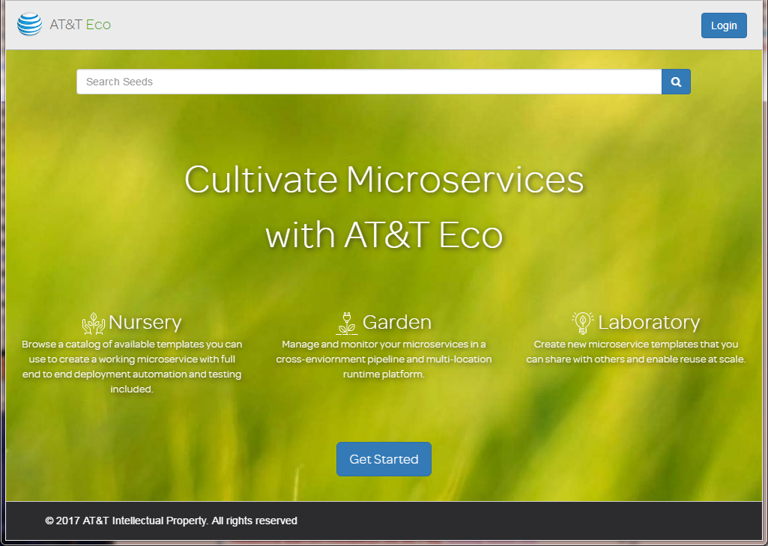
Eco Main Screen
Login using your ATTUID
Click to see a description
Generating the MicroService

Slide 49
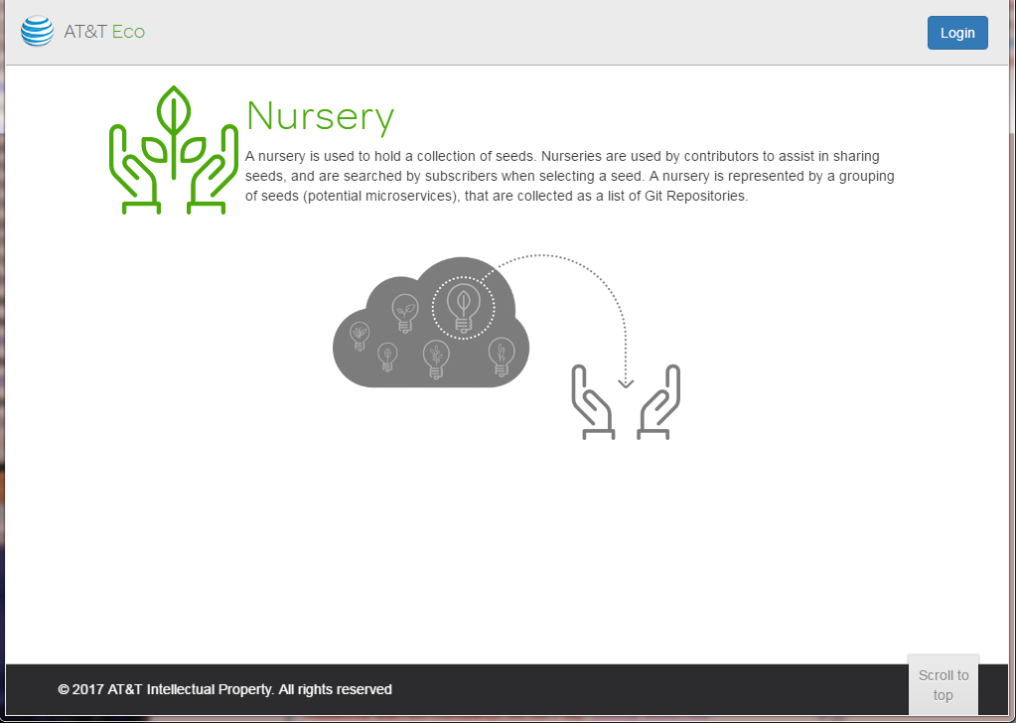
Nursery
Generating the MicroService

Slide 50
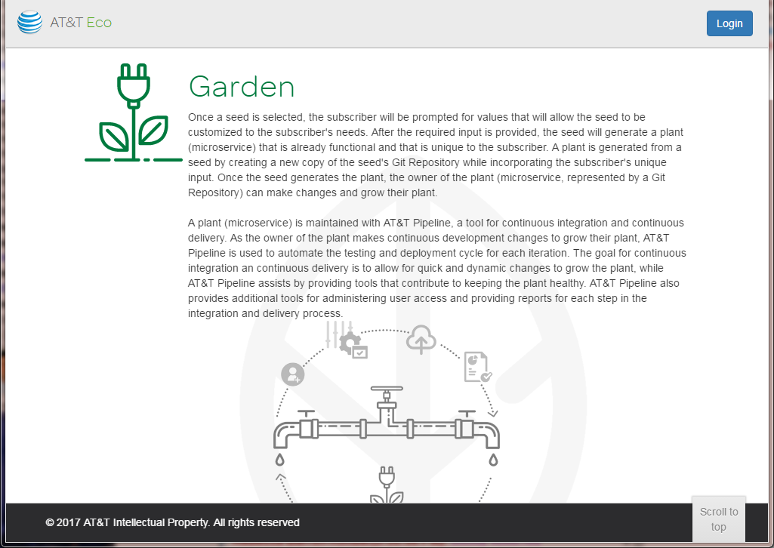
The Garden
Generating the MicroService

Slide 51
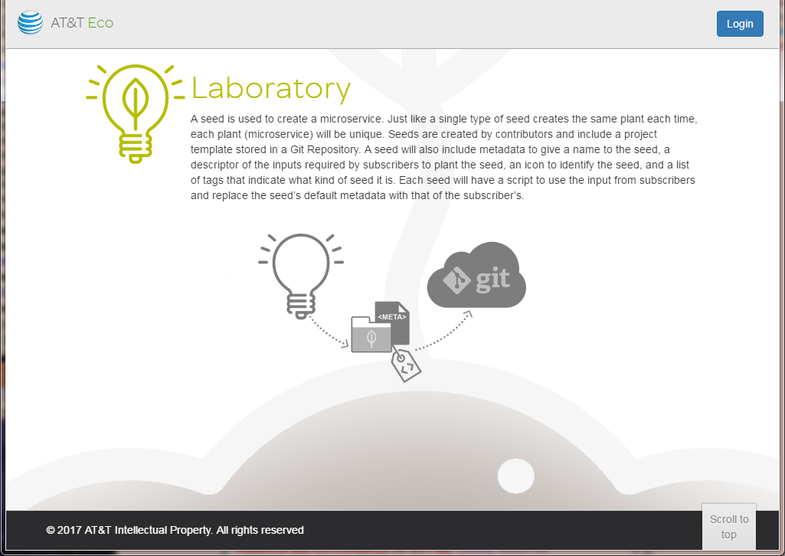
The Laboratory
Generating the MicroService

Slide 52
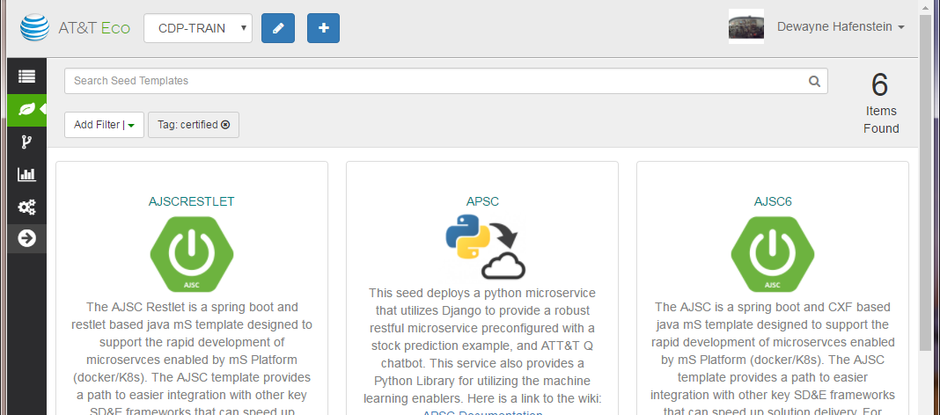
The Eco User Interface
Current Selected Application
Register
a MOTS ID
with ECO
Define a
new Application
in Eco
Current User,
plus links to user guides and
to log out of Eco
Menu
Generating the MicroService
Content of selected menu item

Slide 53
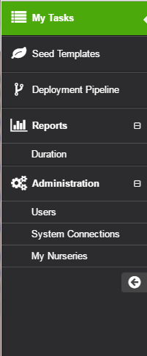
The Eco Menu
My Tasks
Seed Templates
Pipelines
Expand and
“Reports” menu items
Reports
Expand and “Administration” menu items
Administration
Expand and Contract the Menu Bar
Generating the MicroService

Slide 54
More Information
For more information regarding Eco, refer to…
https://wiki.web.att.com/pages/viewpage.action?pageId=563024904
The CDP wiki: https://wiki.web.att.com/display/cdp/Continuous+Deployment+Platform
Generating the MicroService

Slide 55
Check Your Progress

Slide 56
Exercises
A+
Generating the MicroService
Eco is the all-important API tool used to generate the microService. | True/False
ECO creates the pipeline, and then releases it to your preselected management software. | True/False
You register a MOTS ID with IDE. | True/False
Correctly implemented, Eco will completely manage the project repository in Git for you. | True/False
Nursery is an example/representation of a microService. Seeds represent CDP tools. | True/False
APSC deploys a python microService that utilizes Django. | True/False
Seeds are made to contain two sets of metadata simultaneously: (1) default metadata, and (2) custom subscriber metadata. | True/False

Slide 57
Contents
Introduction
Design of the MicroService
Understanding and Employing Patterns
Environment Setup
Generating the MicroService
Structure of an AJSC MicroService
Design and Documentation
Performing Local Testing
Building the MicroService

Slide 58
What the Template Generates
Git Repository
Maven Project
Generate
1
Template
2
3
4
Jenkins
1
Eco creates the Git repository for the microService.
2
Eco creates the initial Maven project and pushes it into the Git repository.
3
Eco creates the initial project content, including sample source files, resources, documentation, and other artifacts as needed. This is just the starting point.
4
Eco configures the Jenkins build system to build the microService.
Structure of an AJSC MicroService
Notes:
When a microService is generated using ECO, the selected template is used to create…
…the Git repository (within the CodeCloud project)
…the Maven project and initial contents
…the pipeline used by Jenkins to build the microService

Slide 59
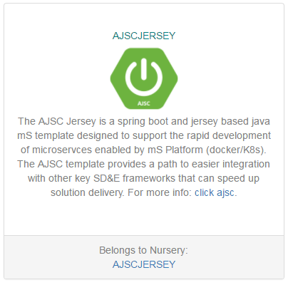
Generated AJSC Java MicroService Project
The example used in the course is the AJSC Jersey template
All others are similar.
The example shown here is representative.
The template generates a java-based microService that uses AJSC, Jersey, and Spring Boot.
Structure of an AJSC MicroService
Notes:
This is an example of the AJSC Jersey template entry in the “seed catalog” of Eco.
The template builds a java-based microService that uses the AJSC container and Jersey web server.
This is the template that was used for this sample code.

Slide 60
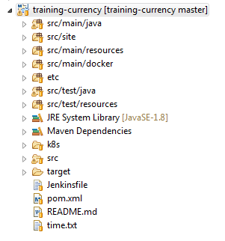
General Project Structure
Additional microService documentation that can be generated
Java source files that are to be used to create the deployed microService
Resource files that are to be used to create the deployed microService
The dockerfile for the microService is located in this directory
Configuration files for logback or other logging frameworks that may be employed
Java test case source used to perform unit tests (Not distributed with the microService)
Resource used by unit tests (Not distributed with the microService)
The configmap, configuration, and service definitions for use in Kubernetes
The Jenkins pipeline definition file generated by the template
A simple read me markdown (MD) file generated by the template
The Maven POM (Project Object Model) File
Used in the build process to generate the time of last build
Structure of an AJSC MicroService
Notes:
The contents of the project generated by the AJSC Jersey template.
This shows the project structure from Eclipse using the project explorer view.

Slide 61
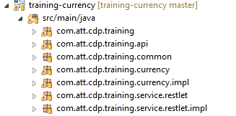
Java Package Structure
The namespace is the package name
In this example, the namespace was com.att.cdp.training
common will contain the log messages
service will contain the API definition and implementation
restlet will contain the API definition interface
restlet.impl will contain the implementation of the API
Other packages can be added to support additional implementation files
All of the generated source will be placed into packages that are under a package with the same name as the microService namespace.
Indicates the initially generated packages
Structure of an AJSC MicroService
Notes:
Whatever the namespace is for your microService will become the package name used to generate the source code for the project.
You can (and should) create additional packages underneath the namespace hierarchy to contain your implementation files.
The packages shown with the arrows to the right of them are the packages created by the template.
You can add source files to these packages, as well as adding other packages (both were done in this example).

Slide 62

Documentation Generation
API documentation is generated using Swagger
Swagger runs as a Maven plugin as part of the build process.
Swagger reads java annotations embedded in the API definition and any data objects to create the documentation.
Swagger does not read the javadoc, or the code. All input to Swagger is via annotations.
Swagger recognizes many of the standard JAX-RS annotations, and adds several more for its purpose.
Swagger ignores all source and resources that are not annotated as swagger inputs.
A lot of the swagger generated site contents are created for you by the template (/src/main/resources/META-INF/resources/swagger).
/src/main/resources META-INF/ resources/ swagger
WebConfig
Swagger Annotated File
Swagger
/META-INF/resources
/swagger
index.htm
swagger.json
*.js
…
Non-Swagger annotated source file
X
Structure of an AJSC MicroService
Notes:
The generated project uses the Swagger tool to generate API documentation.
Swagger reads the annotations in your source to construct HTML content that can be served as a web application.
The generated documentation is deployed along with the microService in the same jar file.

Slide 63
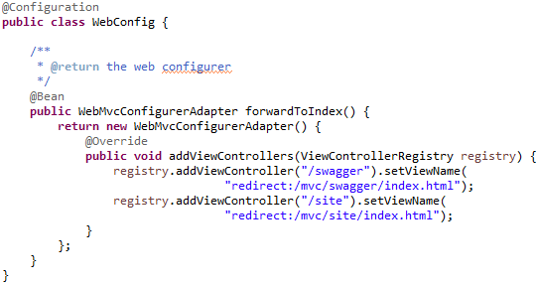
Documentation Generation
The template generates documentation utilizing the Spring MVC framework
The Sprint MVC (Model-View-Controller) framework serves web content automatically
It uses a class, named <namespace>.WebConfig to supply the configuration of the MVC controllers
It relies on the project generating all documentation under /META-INF/resources
Added to enable serving the generated site documentation per the example
Structure of an AJSC MicroService
Notes:
The template also uses the Spring Boot and Spring MVC frameworks. The MVC framework is used to serve the generated documentation that is included in your microService project.
MVC is controlled by a Spring bean named WebConfig that is generated. If you want to extend the documentation and include other paths, such as the generated site or other resources, then you will need to add to this class to define your different controllers.

Slide 64


The Generated Service API
A Java Interface is generated
It contains the definition of the API and all operations.
Annotations are added to describe the API path and for generating documentation in Swagger.
The @API annotation…
…informs swagger this is a file that needs to be processed.
…the value argument is no longer used after swagger 1.5.x and can be removed.
The @Path annotation…
…is the standard JAX-RS annotation that defines the context path.
The interface will be named “RestletService”
As generated
Corrected for swagger releases 1.5.0 and later
Structure of an AJSC MicroService

Slide 65
An Operation of the API
Each operation in the API is also annotated
The template generated annotations are not complete.
The generated contents do not show how to annotate parameters or return data.
Annotation is a little more complicated because of the use of Apache Camel.
Camel is a message automation and routing framework that is embedded within AJSC
Camel intercepts all inputs to the AJSC container and wraps them as an “Exchange” object.
Camel injects itself within the normal web flow, so the information presented to the service is not a standard web servlet interface, but a Camel message processor interface.
This means that the normal JAX-RS annotations used in web-based servlets will NOT work correctly.
This also means that the Swagger annotations that rely on JAX-RS will also NOT work correctly.
Not to worry, Swagger has the ability to annotate “Implicit” parameters that will solve the issues.
Structure of an AJSC MicroService
Notes:
Normal JAX-RS annotations cannot be used because the service API is implemented as a Camel processor.
This encapsulates all of the web request and response as a Camel Exchange object, and does not expose path parameters, body entities, or query parameters in the method argument list.
These are now available in the exchange, but you have to write code to access them and they can be annotated using JAX-RS annotations.
This means that the Swagger annotations to document the normal JAX-RS parameters, and their support for those annotations, can’t be used either.
However, Swagger does provide another annotation, called the “Implicit” parameter annotation, that can be used.
It is provided for just these sort of cases, but you have to identify everything about the parameter as part of the annotation.
This is because Swagger cannot determine anything from the Exchange class directly.

Slide 66

Jersey, Camel, and your Service
AJSC
Jersey Web Server
Apache Camel
Exchange
microService (Camel Processor)
Request
Response
In Message
Out Message
Request
public void operation(Exchange exchange) { … }
Routes
Structure of an AJSC MicroService
Notes:
In AJSC, the Jersey web server is used to handle all HTTP requests and responses, but these are mapped directly into Apache Camel and not on to your microService.
Normal web application rules and techniques are not used in this case.
Camel intercepts the servlet interface and wraps the requests and responses in an Exchange object, and injects that into a route.
Camel is a message automation, or message mediation, framework.
This means that it can make decisions about messages that are presented to it, and route that message among any number of processors.
The Jersey web server is only one source and sink for messages.
Other sources and sinks can be defined and added to AJSC as needed.
The exact processing performed on any message presented to Camel is defined by a route definition.
At a minimum, the route can direct the message to be presented to a single processor and the output returned to the endpoint.
That is the default that is generated by the template, but it is not the only possible route.
You can enhance the route as needed and modularize processing of a message across any number of processors, spawn copies of the message, perform synchronous or asynchronous processing, and any number of other advanced capabilities.
This is all defined by the route definition.

Slide 67
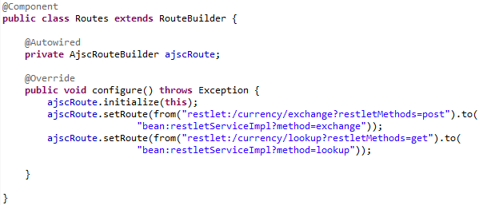
Camel Routes
Named “<namespace>.Routes.java”
The route class extends RouteBuilder and uses Spring to configure the routes.
@Component annotation is required and tells spring that it is part of the configuration.
@Autowired annotation causes Spring to inject the reference to the AJSC route builder object into the reference.
The “setRoute” method creates a message automation route.
A route minimally consists of a from endpoint and a to endpoint.
Endpoints are identified using a URI.
The from endpoint is mapped to the restlet interface in Jersey and accepts web requests from external clients. The path and resource are identified as part of the route. The accepted method(s) can be identified as query parameters.
The to endpoint identifies the bean (java object) and the method on the bean that processes the exchange..
The message processing routes are defined in a java class
See http://camel.apache.org/uris.html for more information about Camel endpoint URIs
Structure of an AJSC MicroService
Notes:
The Camel routes that define how messages are processed is implemented as a java bean.
The example route is shown on the right side of the slide above.
The call to setRoute creates a route definition and defines the from and to endpoints.
Each endpoint is defined using a URI (Universal Resource Identifier) that is unique to Camel.
The list of all supported Camel endpoint URIs and their syntax can be found at http://camel.apache.org/uris.html

Slide 68
The API Operation Definition
Each API operation is a method defined in the interface and implemented in the service.
The operations are added to the RestletService interface in the <namespace>.service.restlet package.
Each operation must be an Apache Camel Exchange processor. This requires a specific signature, of the form:
public void operation_name(Exchange exchange)
All request and response information (entities, headers, query parameters, etc.) is packaged as part of the Exchange object provided to the method.
Because the entity (if any), headers, query parameters, and other parts of the request are packaged in the Exchange object, normal JAX-RS annotations do not apply. This makes generating the documentation a little less obvious, but can be accomplished using the @ApiImplicitParam annotation in swagger.
Structure of an AJSC MicroService

Slide 69
Exchange Message Structure
HttpRequest
Exchange
Message
Body
header
header
property
header
header
property
header
property
header
URL
Camel RestLet
In
body
Query
API Operation Implementation (Camel Processor)
Out
fault
entity
httpResponse
Message
Body
header
header
header
header
header
header
URL
body
entity
fault
Structure of an AJSC MicroService
Notes:
This diagram shows that the incoming request from the web client is presented to the Camel Restlet endpoint.
The restlet maps the HttpRequest contents into the Camel exchange object structure. This consists of the Exchange, the In Message, and the Body (if any).
The HttpRequest URL, query parameter string, and extra path information is extracted and inserted into the In Message header collection (a name-value map).
Any HTTP headers attached to the inbound request are also copied into the message header collection, as well as the HTTP method and other metadata information.
If an inbound request contained an entity, the entity is extracted and attached to the In Message as a body object.
The exchange object is then presented to the message processor(s) identified on the route.
Each message processor processes the In message, takes some action, and creates the Out message.
When the exchange structure is returned to the restlet endpoint, the Out message is used to create the HttpResponse to be returned to the caller.

Slide 70
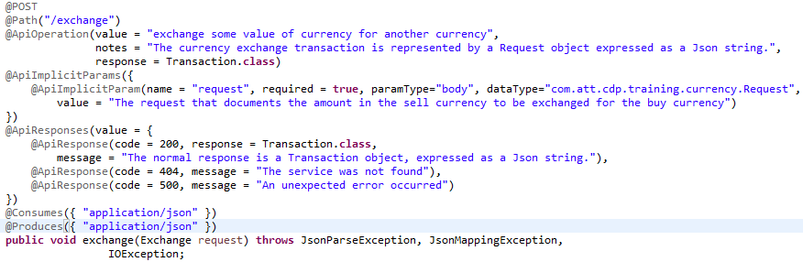
An Example of an API Operation Declaration
The HTTP Method that the client uses to access the operation
The resource path to the operation (relative to the context path)
Swagger annotation that documents the operation
A collection of one or more Swagger ImplicitParam annotations
The collection of annotations that document all of the possible responses
Standard JAX-RS annotations that define the MIME types for inputs and outputs
The java method that implements the operation. This must be the method name used in the “To” endpoint definition in the route.
Structure of an AJSC MicroService
Notes:
This shows the API method (operation) declaration in the microService API interface.
The method simply accepts a single parameter, of type Exchange.
All input and output is encapsulated within the Exchange object.
This is the signature of a Camel message processor, and is exactly what these methods are.
Because the parameters and inputs from the end user web client are encapsulated as part of the exchange object structure, we have to use the Swagger @ApiImplicitParam annotation to document the inputs.
The ApiImplicitParam annotation is contained as a list inside an ApiImplicit (notice the plural form) annotation.
Each implicit parameter supplies the name of the parameter, if it is required or optional, the type of the parameter, data type of the parameter, and a description (value) of the parameter.
This information is used to create the API documentation.

Slide 71
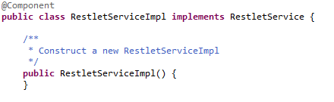
Implementing The Service
The service implementation is …
…annotated as a Spring Component.
…implements the API interface.
…must contain a public, no-argument constructor.
It must implement the service API interface.
Defines the class as a Spring component.
It must have a public, no-argument constructor so that Spring can create an instance when needed..
Structure of an AJSC MicroService

Slide 72
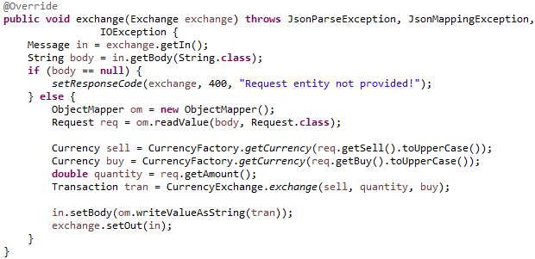
Example of Handling Entities
An entity provided by the client is packaged in the “In” message
The “In” message is obtained from the exchange
The body (entity) is obtained from the message
The body may be unmarshalled into an object graph for processing
This example passes a json string which is converted into an object of type “Request”
Response entities are placed in the returned message
By convention, the In message is modified and placed back into the exchange as the out message so that the message can be passed to the next processor in the route, creating message “chains” or complex processing sequences if needed.
This example creates a response as a Transaction object, then marshals it as a json string and attaches it to the message as the body (entity).
Structure of an AJSC MicroService

Slide 73
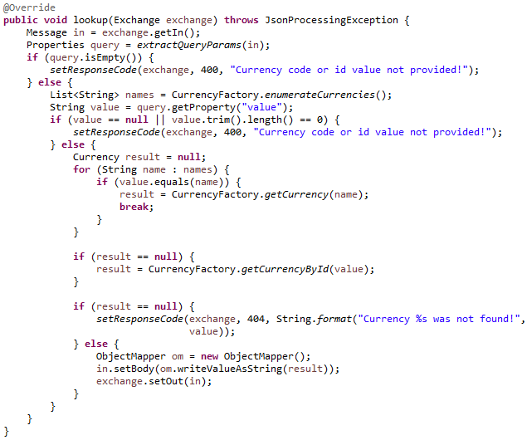
Handling Query Parameters
Query parameters on input are placed in the message as header properties
The example shows the extraction of query parameters and processing using them.
A helper method extracts all the query parameters and creates a “Properties” object to contain them.
The Properties object allows us to retrieve the value of any query parameter by using its name as the key to the Properties.
A response entity is created as before.
Several helper methods are used, which are explored next.
Structure of an AJSC MicroService

Slide 74
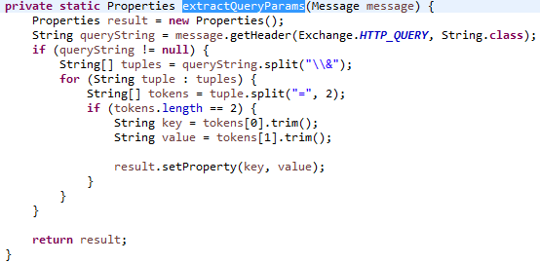
Extracting the Query Parameters from the Message
Camel inserts the entire query string as a single header that needs to be parsed
The header name is “CamelHttpQuery”, or use the constant as shown (preferred).
The query parameters are delimited (separated) by the “&” symbol and consist of key=value pairs.
To convert them to properties, first split the query string into the key=value pairs, then split each pair into the key and value and add them to the Properties object.
Don’t forget to trim off any leading or trailing whitespace!
This method will return an empty Properties object if called and no query parameters exist in the message.
Structure of an AJSC MicroService

Slide 75
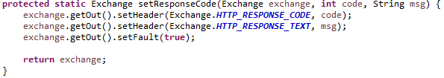
Returning an HTTP Response in Case of Error
There are times when things fail!
The service needs to be able to return a failure response.
Setting a response involves three parts:
Setting the HTTP response code
Setting an HTTP error message
Setting the fault indicator in the message
The fault indicator is needed to tell Camel that the processing failed.
If no out message exists yet, Camel will implicitly use the In message as the response.
Structure of an AJSC MicroService

Slide 76
Check Your Progress

Slide 77
Exercises
A+
Structure of an AJSC MicroService
AJSC uses Apache Camel to perform message mediation. | True/False
Apache Camel message processors receive the normal Jax-RS parameters as part of their method signature. | True/False
In order to get an input message presented to an API method I need to define both the method and add it to the route for Camel. | True/False
I can use the normal JAX-RS annotations to document the API method. | True/False

Slide 78
Contents
Introduction
Design of the MicroService
Understanding and Employing Patterns
Environment Setup
Generating the MicroService
Structure of an AJSC MicroService
Design and Documentation
Performing Local Testing
Building the MicroService

Slide 79
Template-Generated Content
The template only generates minimal documentation
It does not generate documentation for the parameters.
It does not generate documentation for input and output data objects or complex structures.
It does not generate or demonstrate how to enhance the documentation and include other forms and content.
Using the template as-is is not very good, but it is a good starting point…
…exactly what it is intended to be!
The template will need to be enhanced it to meet your needs.
The template cannot possibly generate all the documentation that you might need. YOU HAVE TO DO THAT!
Design and Documentation

Slide 80
API Documentation May Not Be Sufficient
API documentation alone will usually not be sufficient
There is almost always a need for additional documentation.
Much of the documentation can be generated from the source code.
Javadocs
XML schema documentation
Maven project reports, which include dependencies, SCM change logs, and much more
Some information may need to be created.
Design information such as overviews, architecture, structure, how-to’s, etc.
Business domain information, such as process, use case, class, or activity diagrams and models
Definitions of terminology
Guides and project standards and techniques
Generating some of this on an external wiki is one option.
Alternatively, you could generate it as part of the microService itself and link to it from the wiki if needed.
Design and Documentation

Slide 81
The Maven Site Plugin
Maven has a plugin that can be used to generate documentation
The plugin is called the "site" plugin.
It is used by Apache to generate all of the project documentation for their projects.
It generates a web site that can be published as part of the microService and accessed just like the Swagger documentation.
The site plugin reads the site descriptor file
The site definition file is high-level configuration that tells the plugin how to generate the site, and includes:
Page banner and footer information
Version information
Skins for look and feel
Headers
Navigation breadcrumbs
Menu items
Footers
Custom content
Design and Documentation

Slide 82
The Site Content Structure
The site plugin assumes all content is located…
…starting at the site root directory (src/site).
…relative to the site root directory.
The POM configuration of the plugin can be used to control processing
Site documentation generation may be separated into a profile and run on demand if desired.
This can be used to prevent documentation generation during normal development builds, and then run during CI/CD builds.
It can always be run on demand if desired within the developers environment.
The site plugin can use different documentation formats
Wiki text, APT (almost plain text), markdown (MD), and many other formats are supported.
These formats make it easier to generate content.
Design and Documentation

Slide 83
POM Additions
In the sample project, the POM was enhanced to run documentation generation as a profile
The profile name is ”site.”
The profile is not activated unless explicitly requested.
<!-- =================================================================== -->
<!-- Added the reporting definitions to generate the site for the -->
<!-- project. -->
<!-- =================================================================== -->
<profiles>
<profile>
<id>site</id>
<build>
...
</build>
<reporting>
...
</reporting> </profile>
</profiles>
Configures the plugin(s) that are used to generate the site.
Configures what reports and options are included in the site.
Design and Documentation

Slide 84
Site Generation Configuration
<build>
<plugins>
<plugin>
<groupId>org.apache.maven.plugins</groupId>
<artifactId>maven-site-plugin</artifactId>
<configuration>
<generateProjectInfo>true</generateProjectInfo>
<generateReports>true</generateReports>
<generateSitemap>true</generateSitemap>
<outputDirectory>${project.build.directory}/classes/META-INF/resources/site</outputDirectory>
<reportPlugins>
<plugin>
<groupId>org.apache.maven.plugins</groupId>
<artifactId>maven-project-info-reports-plugin</artifactId>
</plugin>
<plugin>
<groupId>org.apache.maven.plugins</groupId>
<artifactId>maven-javadoc-plugin</artifactId>
</plugin>
</reportPlugins>
</configuration>
<executions>
<execution>
<id>attach-site</id>
<phase>prepare-package</phase>
<goals>
<goal>jar</goal>
</goals>
</execution>
</executions>
</plugin>
</plugins>
</build>
Includes the Maven site plugin.
Select the optional content you desire.
Use a "site“ sub-directory under the same resources in the target as used by Swagger.
This allows the content to be served by Spring MVC automatically.
Design and Documentation

Slide 85
Project Info Reports
If reporting is selected in the site plugin, then the configuration can be controlled
Using the maven-project-info-reports-plugin as a part of the <reporting> definition in the profile…
…allows you to select specific reports to include in your site.
<reporting>
<plugins>
<plugin>
<groupId>org.apache.maven.plugins</groupId>
<artifactId>maven-project-info-reports-plugin</artifactId>
<version>2.9</version>
<reportSets>
<reportSet>
<reports>
<report>index</report>
<report>dependencies</report>
<report>project-team</report>
<report>mailing-list</report>
<report>cim</report>
<report>issue-tracking</report>
<report>license</report>
<report>scm</report>
</reports>
</reportSet>
</reportSets>
</plugin>
Includes the Maven plugin.
Specifies what reports to generate and include in the site
These reports obtain their information from the project model (POM) and the dependency graph, SCM system, and other sources defined in the POM.
Design and Documentation

Slide 86
Including Javadoc
Javadoc can be included into the generated site
Use the Maven javadoc plugin.
It is configured as part of the profile.
<plugin>
<groupId>org.apache.maven.plugins</groupId>
<artifactId>maven-javadoc-plugin</artifactId>
<reportSets>
<reportSet>
<id>default</id>
<reports>
<report>javadoc</report>
</reports>
</reportSet>
<reportSet>
<id>aggregate</id>
<reports>
<report>aggregate</report>
</reports>
</reportSet>
</reportSets>
</plugin>
Includes the Maven plugin.
Specifies what to generate and include in the site
Design and Documentation

Slide 87
A ChangeLog can be Included
The Site plugin can include a change log from the SCM system
Created by the maven-changelog-plugin and included in the site…
…the plugin is configured as part of the profile.
<plugin>
<groupId>org.apache.maven.plugins</groupId>
<artifactId>maven-changelog-plugin</artifactId>
<version>2.3</version>
<reportSets>
<reportSet>
<id>dual-report</id>
<configuration>
<type>range</type>
<range>30</range>
</configuration>
<reports>
<report>changelog</report>
<report>file-activity</report>
</reports>
</reportSet>
</reportSets>
</plugin>
Includes the Maven plugin.
Specifies what to generate and include in the site
Design and Documentation

Slide 88
Creating a Dependency Report
The Site plugin can also include a report of the project dependencies
Created by the maven-dependency-plugin and included in the site….
…the plugin is configured as part of the profile.
<plugin>
<groupId>org.apache.maven.plugins</groupId>
<artifactId>maven-dependency-plugin</artifactId>
<version>3.0.1</version>
<reportSets>
<reportSet>
<reports>
<report>analyze-report</report>
</reports>
</reportSet>
</reportSets>
</plugin>
Includes the Maven plugin.
Specifies what to generate and include in the site
Design and Documentation

Slide 89
Creating Custom Content
The Maven site plugin uses Doxia to generate HTML content
Additional information about Doxia can be found here: https://maven.apache.org/doxia/.
Doxia reads source material from the /src/site directory by documentation type and uses that to generate HTML pages.
Doxia supports many different formats, some of which are:
Text Format | Sub-Directory of Site Source | File Extension | Description
APT | /apt | .apt | Almost Plain Text
Confluence | /confluence | .confluence | Confluence enterprise wiki format
Simplified DocBook | /docbook | .xml | DocBook XML standard
FML | /fml | .fml | FAQ Markup Language
Markdown | /md | .md | Markdown markup language
Twiki | /twiki | .twiki | Twiki Structured Wiki markup
XDoc | /xdoc | .xml | XML Documentation Format
Design and Documentation

Slide 90
Links to External Resources
Depending on the content type, Doxia supports links to external content
The format of the link will vary depending on the document type.
Additional information about Doxia can be found here: https://maven.apache.org/doxia/.
A link to the training wiki page, for example, would be created as follows (where “text” is the displayed text for the link, and the URL is the “tiny” URL from Confluence for the wiki page):
Content Type | Example Link
APT | {{{https://wiki.web.att.com/x/lwlPlw}text}}
Confluence | [text|https://wiki.web.att.com/x/lwlPlw]
DocBook | <ulink url=“https://wiki.web.att.com/x/lwlPlw”>text</ulink>
FML | <link href=“https://wiki.web.att.com/x/lwlPlw”>text</link>
Markdown | [text](https://wiki.web.att.com/x/lwlPlw)
Twiki | [[https://wiki.web.att.com/x/lwlPlw][text]]
XDoc | <a href=“https://wiki.web.att.com/x/lwlPlw”>text</a>
Design and Documentation

Slide 91
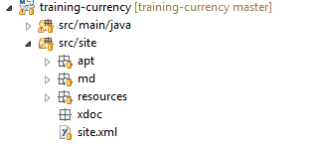
User Content Directories
All user content and the site descriptor are located under /src/site.
All APT content
Each file generates one HTML file with the same name in the same relative path.
All generated HTML files are copied into the target directory to create the site content
All Markdown content
All XDoc content
Web Site
Design and Documentation

Slide 92
The Site Generation Process
Target
Site Descriptor
Maven site plugin
doxia
Maven project info reports plugin
Site Content
Site Content
Site Content
Site Content
SCM
Maven change log plugin
Maven dependency plugin
POM
Site Content
Site Content
Maven javadoc plugin
Source Files
Design and Documentation

Slide 93
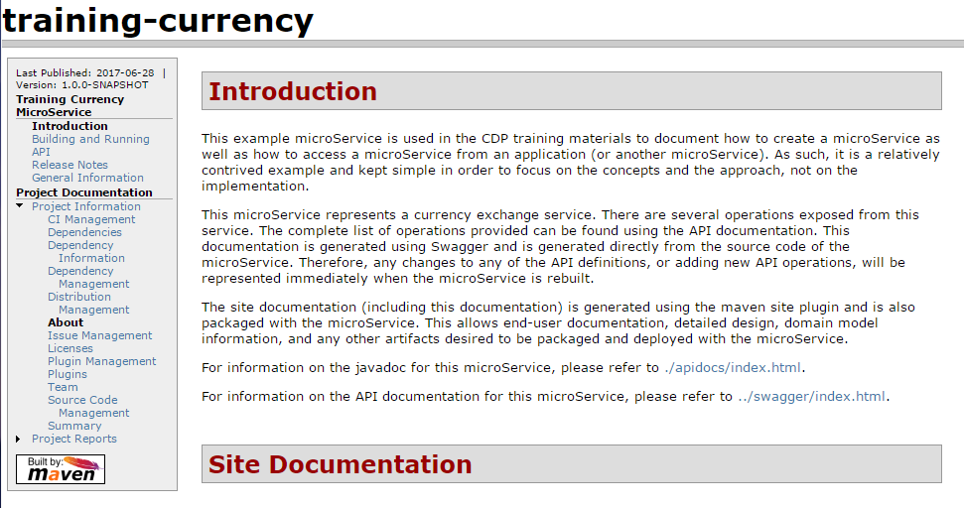
Site Output Example
Design and Documentation

Slide 94
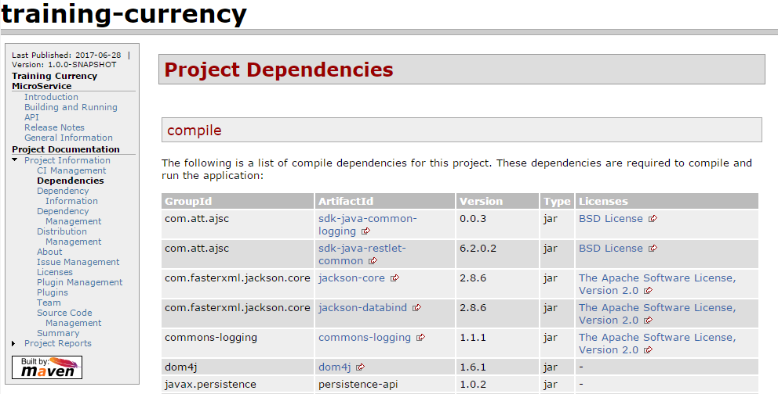
The Dependency Report
Design and Documentation

Slide 95
The Site Descriptor File
The Site descriptor file is an XML document…
…located in src/site.
…named site.xml.
…uses the <project> root element.
Full documentation about the site plugin can be found on the Apache web site:
https://maven.apache.org/plugins/maven-site-plugin/
Full documentation about the site definition file can be found on this site:
https://maven.apache.org/plugins/maven-site-plugin/examples/sitedescriptor.html
Design and Documentation

Slide 96
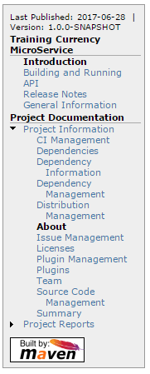
Example Site Descriptor
<project xmlns="http://maven.apache.org/DECORATION/1.7.0"
xmlns:xsi="http://www.w3.org/2001/XMLSchema-instance"
xsi:schemaLocation="http://maven.apache.org/DECORATION/1.7.0 http://maven.apache.org/xsd/decoration-1.7.0.xsd"
name="Currency microService" combine.self="merge">
<publishDate position="navigation-top" format="yyyy-MM-dd" />
<version position="navigation-top" />
<poweredBy>
<logo name="Maven" href="http://maven.apache.org/"
img="http://maven.apache.org/images/logos/maven-feather.png" />
</poweredBy>
<body>
<menu name="Training Currency microService">
<item name="Introduction" href="index.html" />
<item name="Building and Running" href="building.html" />
<item name="API" href="api.html" />
<item name="Release Notes" href="release-notes.html" />
<item name="General Information" href="about.html" />
</menu>
<menu ref="reports" />
<footer><![CDATA[&copy; 2017 AT&T. All rights reserved.]]></footer>
</body>
</project>
Design and Documentation

Slide 97
Resources
Additional resources can be included in the site
Graphics, wav files, and other resources can be included in your web site.
They are placed under /src/site/resources directory.
They are copied into the generated site in the same relative location.
/src/site/resources
graphic.png
icon.png
/sounds
ping.wav
/META-INF/resources/site
graphic.png
icon.png
/sounds
ping.wav
Design and Documentation

Slide 98
Check Your Progress

Slide 99
Exercises
A+
Design and Documentation
The default templates include support to generate documentation using the Maven Site plugin. | True/False
A good way to generate documentation is to define the process as a profile in your Maven POM and to activate it when required. | True/False
The site plugin can generate standard reports from the project definition. | True/False
The site plugin supports additional documentation in many different formats. | True/False
All additional site documentation must be in the same format. | True/False

Slide 100
Contents
Introduction
Design of the MicroService
Understanding and Employing Patterns
Environment Setup
Generating the MicroService
Structure of an AJSC MicroService
Design and Documentation
Performing Local Testing
Building the MicroService

Slide 101
Unit Testing
A Junit test case is generated as part of the template
The Junit test case uses the SpringJUnit4ClassRunner test runner.
Provided with Spring
Supports Spring Test annotations
Implements the Spring Test Framework
Supports the Spring TestContextManager which loads the application contexts
The AJSC server is automatically started as part of the test case because…
…of the inclusion of the @SpringBootTest annotation.
…the restlet is deployed and can be exercised by Junit test cases.
…the AJSC server runs in the same process as the Junit test cases.
…it can be run under Eclipse or as part of the Maven build.
Performing Local Testing

Slide 102
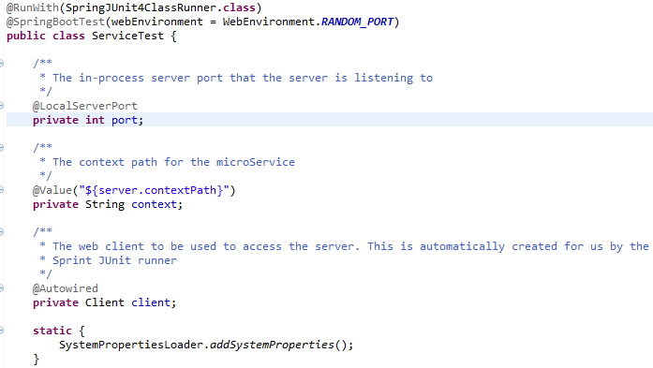
Spring Boot Test Case
Uses the Spring test runner class
Determines the port number the in-process server will listen to. Can be DEFINED_PORT or RANDOM_PORT.
Loads the Spring Boot Test support, activates the web environment
Injects the port number assigned to the in-process server
Injects the web context root for the microService
Injects a web client created for the test case to access the microService
Performing Local Testing

Slide 103
Setting the Port
The @SpringBootTest annotation starts the web environment
It starts the AJSC server container, including Jersey and Camel.
The microService is automatically deployed as part of the AJSC container.
It specifies the port assigned to the server (webEnvironment argument).
RANDOM_PORT
Assigns a random (ephemeral) port number.
Use this for tests run as part of the build process (the build server may use a statically defined port already).
DEFINED_PORT
Assigns a port number using the property “server.port.”
If no property is defined, the port is ephemeral.
Performing Local Testing

Slide 104
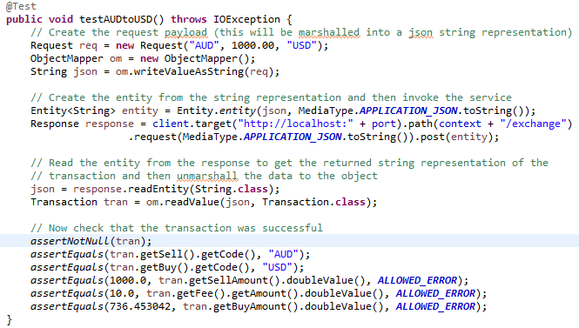
Test as Usual
Test the microService
The test case has the client, port, and context root injected and available to the test case.
Use the provided server port
Standard Junit 4 test case annotation
Use the provided context root
Use the provided client
Add resource path as needed to access the service operation
Use assertions as usual to verify that the service is correct
Performing Local Testing

Slide 105
Check Your Progress

Slide 106
Exercises
A+
Performing Local Testing
The generated Junit test cases use the Spring Test framework. | True/False
The test cases are written as usual. | True/False
The test class uses annotations to specify the Spring test runner and web environment. | True/False
The Spring Boot Test annotation causes the AJSC server to be started, a client to be constructed, and the port to be set. | True/False

Slide 107
Contents
Introduction
Design of the MicroService
Understanding and Employing Patterns
Environment Setup
Generating the MicroService
Structure of an AJSC MicroService
Design and Documentation
Performing Local Testing
Building the MicroService

Slide 108
Maven Build
The template generates a Maven project.
It is built as for any Maven project.
Specify the documentation profile name if the doc generation is added as a profile (as suggested in this course).
The Maven POM can be built by Eclipse, Maven, or Jenkins.
If using Eclipse, it is sometimes better to use an external Maven installation.
Maven integration in eclipse is part of the m2eclipse plugin.
The version of Maven installed with the plugin is not under your control.
By using an external Maven install, you can control the Maven environment.
To install and use an external Maven home:
Install Maven of your choice.
Define the M2_HOME environment variable .
Define the external Maven installation in eclipse preferences.maven
Building the MicroService

Slide 109
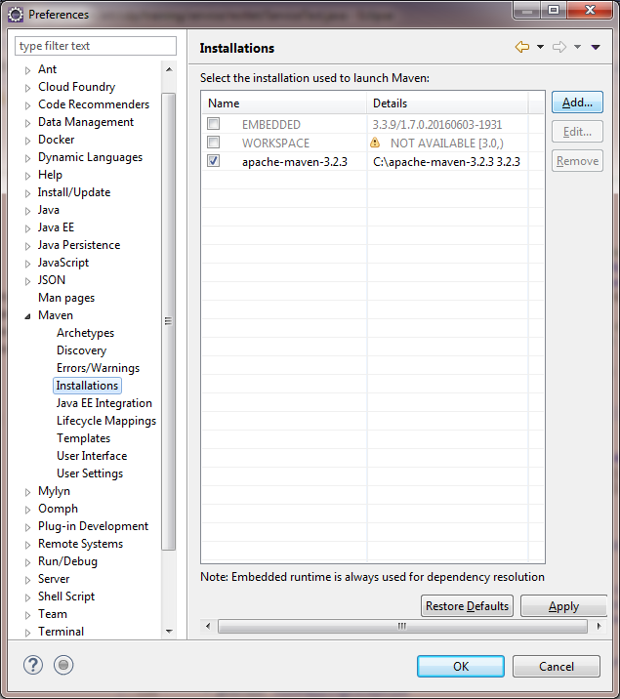
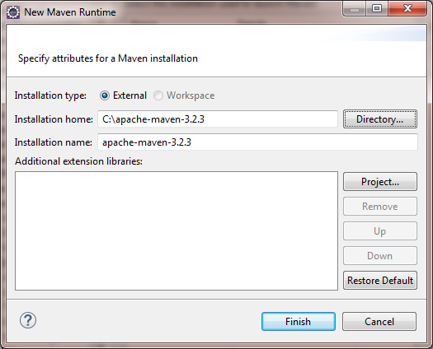
Adding an External Maven Installation to Eclipse
Open the eclipse preferences
1
Expand the Maven group
2
Select the “Installations” topic
3
4
5
Click the “Add” button
6
Select the Maven installation that you want to use by default on all new run configurations.
7
Click the “Directory” and select the installation directory of Maven. Eclipse will automatically discover the rest!
Click “Finish” to add the Maven external installation
Building the MicroService

Slide 110
Why Use External Maven Installation(s)
You have more control…
The version of Maven when using the integrated support is defined by the plugin
You can create any number of Maven installations and support different versions if needed
You can use the external Maven from the command line to perform operations outside of eclipse
The eclipse m2e plugin will still provide all the normal functions but use the external Maven installation
You can still access the global settings, repository locations, and other aspects of Maven as usual
Building the MicroService

Slide 111
Run Configurations
Eclipse creates “Run Configurations”…
…each time you tell it to run something
…to enable configuration and reuse of different settings
…to allow you to control the run environment
Run configurations can be created several ways…
Context (right-click) menu “run as” command
Select the object to run, then use “Run” menu item
Run toolbar button and “Run as” option on selection
Run a saved configuration
The same thing applies for debug and external tools (if any)
Building the MicroService

Slide 112
Run Configurations
Run configurations can be saved and reused
Run configurations are named definitions
They can be selected by name
They can be modified if needed
They can be exported and imported, allowing sharing among team members if desired
Run configurations can be displayed easily
“Run” menu -> “Run Configurations…”
Context (popup menu in project explorer) “Run” -> “Run Configurations…”
“Run” toolbar button -> “Run Configurations…”
Building the MicroService

Slide 113
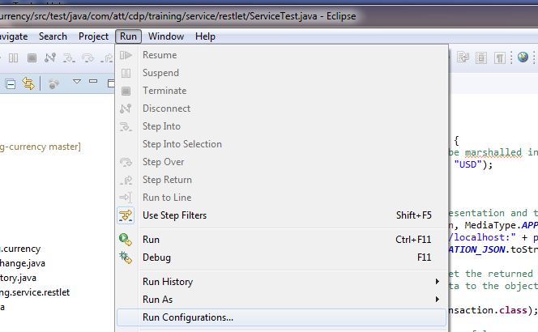
The Eclipse Menu
“Run” menu
Runs the selected item in the project explorer view based on its type
Runs the selected item in the project explorer view based on some type you select. This creates a run configuration based on the options you choose.
Opens all existing run configurations and allows you to alter them, delete them, clone and reconfigure them, create new ones, or to run a selected configuration.
Building the MicroService

Slide 114
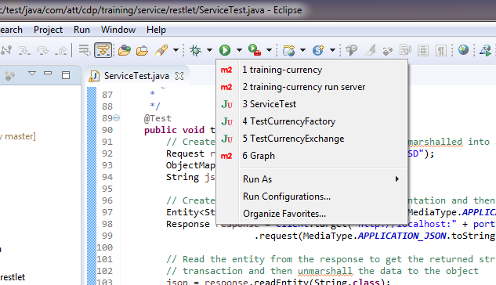
The Eclipse Toolbar
“Run” tool bar button
List of the last run configurations
Opens a list of the last run configurations
Creates a new run configuration for the selected object and runs it
Runs the last selected configuration
Opens the run configurations list
Building the MicroService

Slide 115
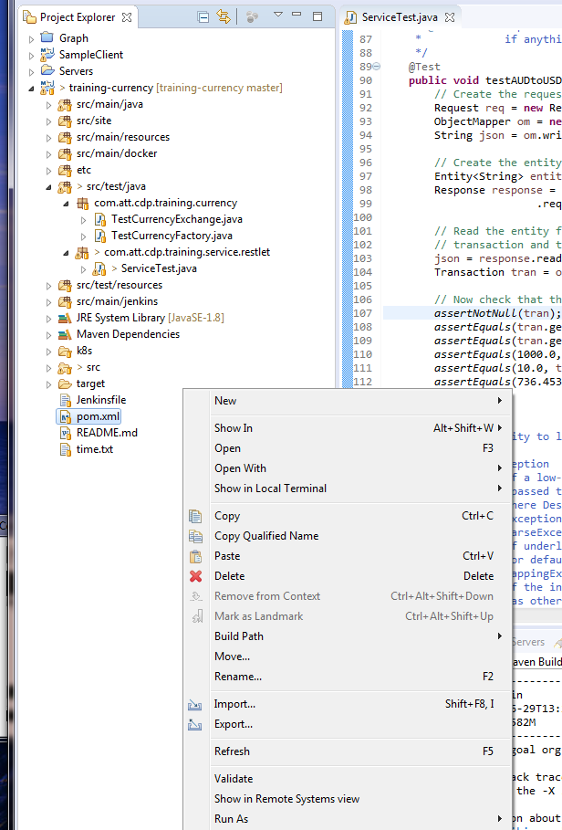
The Eclipse Context Menu
Project Explorer View
Select some object, then right-click
Context menu popup. The contents of this menu will change based on the type of object selected (the context). Run As… is an option when the object is a runnable type. The run configurations can also be accessed from this menu.
Building the MicroService

Slide 116
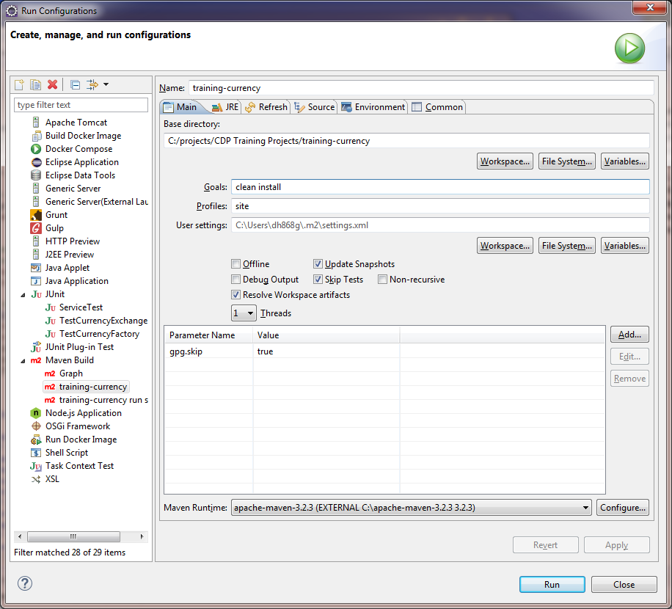
Run Configurations
Configuration name
The types of run configurations that are available.
For example, Junit configurations...
The configurable settings will vary by type of run configuration. For Maven, it will include goals, profiles, parameters, and other settings.
… and Maven configurations
Notice that the Maven runtime to use can be changed
Building the MicroService

Slide 117
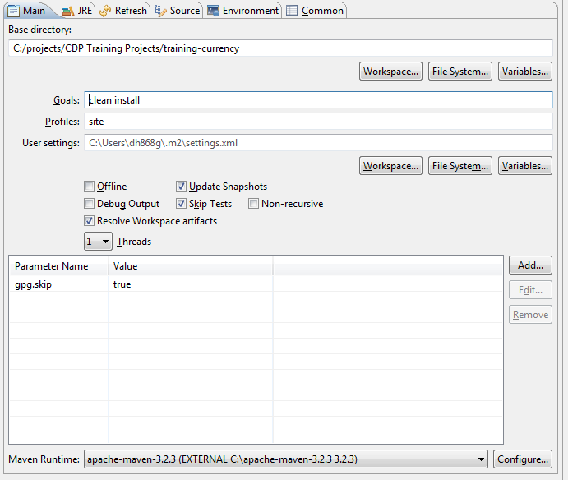
Maven Properties
A Maven run configuration can pass parameters into the build
Parameters allow setting Maven plugin properties and can be used to control the build
The default POM file created by the template may require GPG configuration. This can be turned off with a parameter.
Click “Add” to add a new parameter
Double click to edit, or select and click the “Edit” button
Select the parameter to be removed and click “Remove”
Building the MicroService

Slide 118
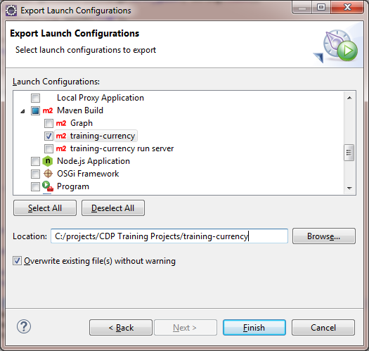

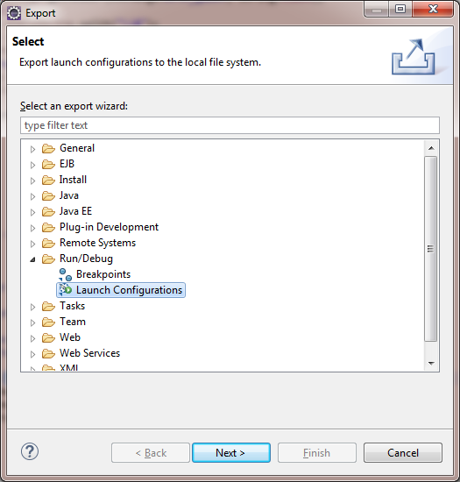

Exporting Run Configurations
1
5
2
3
6
7
4
Building the MicroService

Slide 119
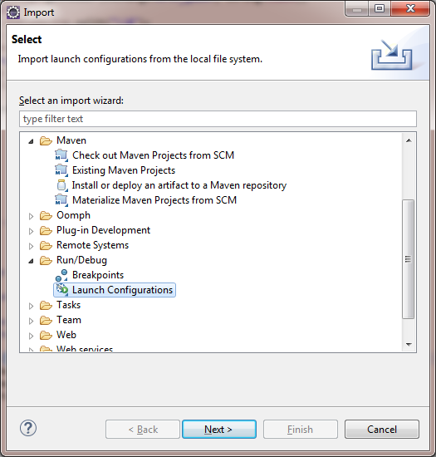
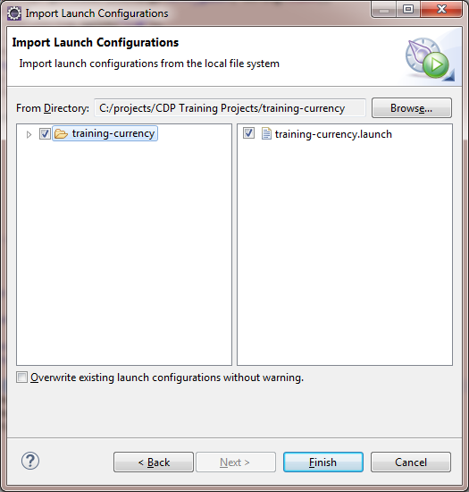
To Import a Run Configuration
1
5
2
6
3
4
7
Building the MicroService

Slide 120
Example MicroService Project
The attached zip file contains an example microService
Building the MicroService

Slide 121
Check Your Progress

Slide 122
Exercises
A+
Building the MicroService
Eclipse can only support one external Maven installation | True/False
You should use the internal, embedded Maven at all times, it provides more control | True/False
Run configurations allow you to configure how an artifact is run and then launch it that way any time you want | True/False
Run configurations can be exported and imported, therefore they can be shared across a team | True/False

Slide 123
Answers to Exercises

Slide 124
Exercises
A+
Design of the MicroService
In DDD, you perform the process of analysis and design once and then your done. No. DDD is an ongoing process that should be a part of your normal development and support activities. The domain model is as much source to the project as any program or artifact source. | False
All concepts or elements within a single bounded context have one, and only one, meaning and behavior. | True
One of the benefits of microServices is that “bounded contexts” are to a degree flexible and arbitrary; therefore, you can create Bounded Concepts as you see fit and are you are no longer quite so tied to the business processes and entities. No. Bounded contexts are a consequence of the business domain where the meaning and behavior of all of the objects within that context is consistent and has a single meaning. Because the meaning of many elements or entities changes based on the context in which they are used, the bounded contexts follow this change in meaning and group together all of the concepts that have exactly one meaning. | False
The domain model consists of just the behaviors of the domain. No. The domain model contains ALL knowledge about the business domain, including structural, behavioral, terminology, constraints, etc.. | False
Context Mapping is the process of determining how two or more contexts exchange information. | True

Slide 125
Exercises
A+
Understanding and Employing Patterns
A microService implements a single pattern. Not necessarily. A microService may choose to use multiple patterns in some combination in order to meet the needs of the microService. | False
A pattern is chosen and the microService implements it exactly as described. No. Patterns are suggestions and approaches to solving specific types of problems in a way that has been proven to be efficient and effective. This does not mean that they cannot be tailored to the needs of the microService. | False
A pattern is an example of a way to solve a specific architectural problem, and can be adapted as needed to meet the needs of the microService. | True
The GoF patterns have no applicability in microServices. No. The GoF patterns have often been the basis for may other patterns and are widely used in all object-oriented software. | False

Slide 126
Exercises
A+
Environment Setup
You do not need to follow the governance process. No. You absolutely must follow the governance process. | False
You do not need to register your microService in the catalog. No. The governance process requires that all microServices must be registered in the microService catalog. | False
You do need an AAF namespace for your microService. | True
A mechid is recommended for access to all of the tools and frameworks used to build your microService. | True
You will need to provide a CodeCloud (Git) project for the microService. | True

Slide 127
Exercises
A+
Generating the MicroService
Eco is the all-important API tool used to generate the microService. No. Eco is the CDP tool used to generate the microService. | False
ECO creates the pipeline, and then releases it to your preselected management software. No. Eco can manage the pipeline for you. | False
You register a MOTS ID with IDE. No. Register a MOTS ID with ECO. | False
Correctly implemented, Eco will completely manage the project repository in Git for you. No. Eco creates the project repository in Git for you. | False
A Nursery is an example/representation of a potential microService. Seeds represent CDP tools. No. A “Nursery” is used by contributors to share seeds. It is “Seeds” that represent a potential microService. | False
APSC deploys a python microService that utilizes Django. | True
Seeds are made to contain two sets of metadata simultaneously: (1) default metadata, and (2) custom subscriber metadata. No. A Seed originally includes default metadata structured to give a name to the seed, a descriptor of the inputs required by subscribers, an icon to identify the seed, and a list of tags that indicate what kind of see it is. However, each seed will also have a script to use the input from subscribers and replace the seed’s default metadata with that of the subscriber’s. | False

Slide 128
Exercises
A+
Structure of an AJSC MicroService
AJSC uses Apache Camel to perform message mediation. | True
Apache Camel message processors receive the normal Jax-RS parameters as part of their method signature. No. The Camel message processors only receive one argument, a reference to an Exchange object. The Exchange object contains all of the input properties, headers, query parameters, and any entity that was provided. These must be extracted from the Exchange object by the method implementation. | False
In order to get an input message presented to an API method I need to define both the method and add it to the route for Camel. | True
I can use the normal JAX-RS annotations to document the API method. No, because there are no Jax-RS parameters exposed as part of the method signature. | False

Slide 129
Exercises
A+
Design and Documentation
The default templates include support to generate documentation using the Maven Site plugin. No. The as-generated project using the template will only generate the Swagger documentation. This course and the sample microService attached and provided shows how to extend that to generate far more comprehensive documentation and to support it as part of your microService. | False
A good way to generate documentation is to define the process as a profile in your Maven POM and to activate it when required. | True
The site plugin can generate standard reports from the project definition. | True
The site plugin supports additional documentation in many different formats. | True
All additional site documentation must be in the same format. No. The site plugin uses the Doxia document processor which can process input in many different formats. Each format is stored in its own directory as part of the site source tree. The resulting generated pages are all copied to the resulting web context in whatever directory structure they are placed in under their content tree. | False

Slide 130
Exercises
A+
Performing Local Testing
The generated Junit test cases use the Spring Test framework. | True
The test cases are written as usual. | True
The test class uses annotations to specify the Spring test runner and web environment. | True
The Spring Boot Test annotation causes the AJSC server to be started, a client to be constructed, and the port to be set. | True

Slide 131
Exercises
A+
Building the MicroService
Eclipse can only support one external Maven installation. No, eclipse can support any number of external Maven installations. In fact, different run configurations can use different versions of Maven if desired. They can all co-exist simultaneously. | False
You should use the internal, embedded Maven at all times, it provides more control. Actually no, the internal, embedded Maven is good for many things and is often sufficient. However, if you desire or need more control, must use a predictable or project-dictated version, or desire to use Maven outside of eclipse, then you will want to use an external installation. | False
Run configurations allow you to configure how an artifact is run and then launch it that way any time you want. | True
Run configurations can be exported and imported, therefore they can be shared across a team. | True

